Slide 1

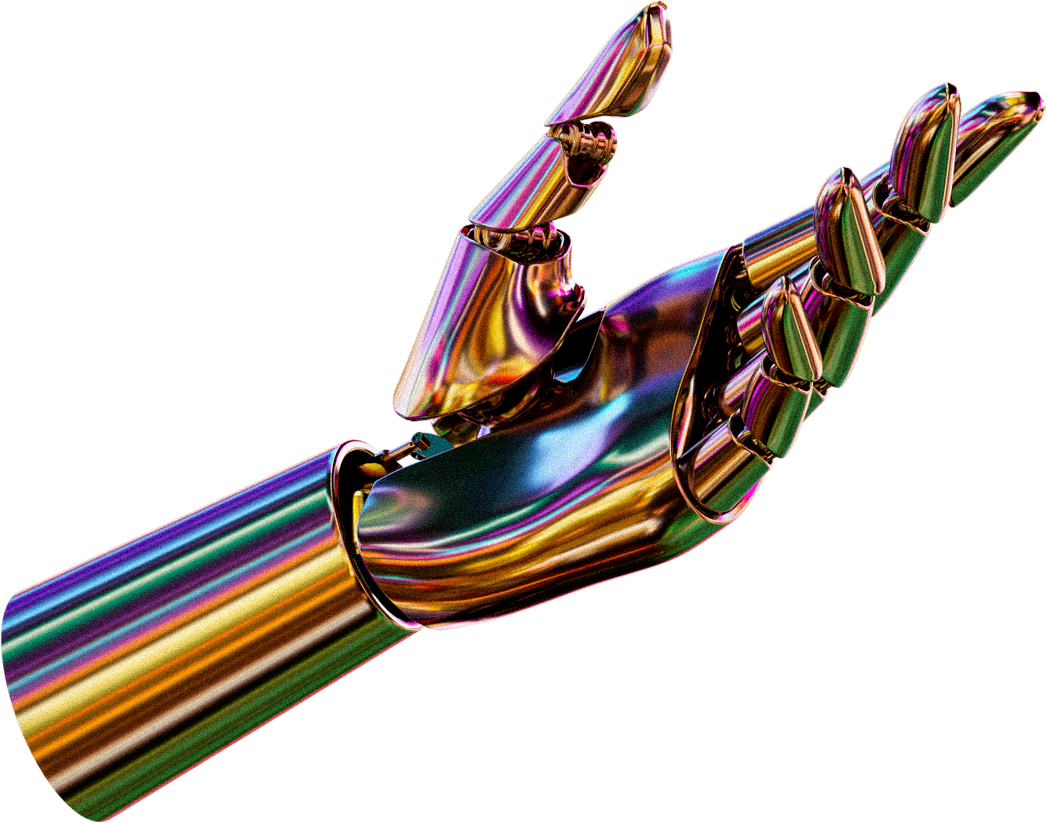

ARTIFICIAL INTELLIGENCE
IN E- COMMERCE

Slide 2
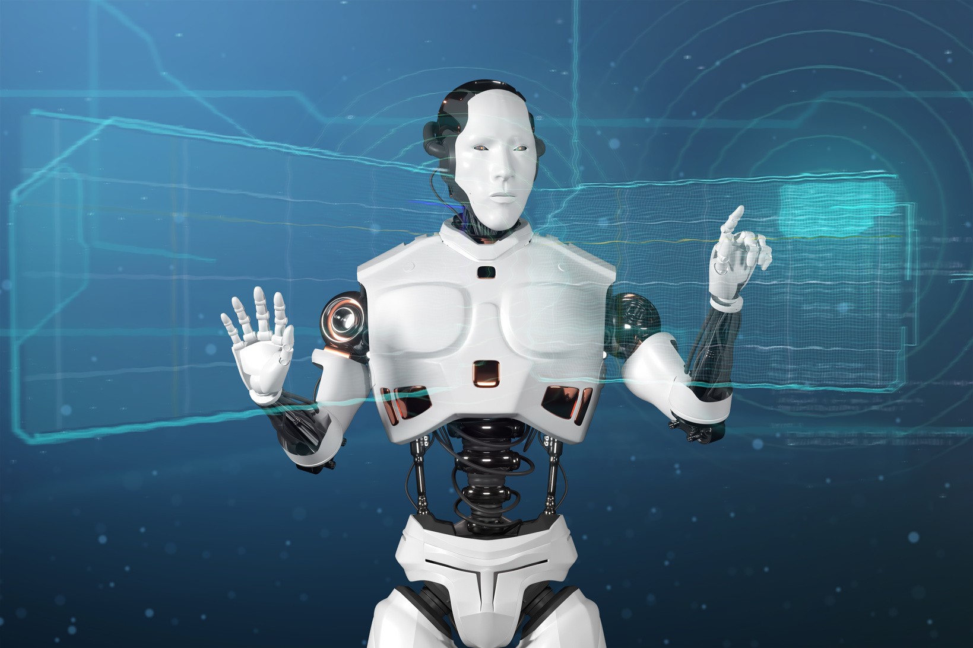
INTRODUCTION
The focus of our project is the development of a sophisticated AI-assisted demand prediction system with reference to the B2B market of Qwipo. The essence is to empower the retailers through accurate predictions of the demand of products.
The solution uses the past sales history, seasonal behavior, and new trends in the market to come up with precise demand forecasts of individual products. With the examination of these many dimensions, the system is able to predict the changes in demand and offer actable insights.
In addition to prediction, the platform also provides the personalized recommendation and intelligent reorder alerts, so retailers do not have to overstock or understock products. It assists business to optimize inventory levels, enhances average order value and customer satisfaction and retention.
Simply, our AI platform will convert raw data into strategic data, allowing Qwipo and retail partners to make wiser, data-driven buying decisions, and remain competitive in an ever-changing market.
03

Slide 3



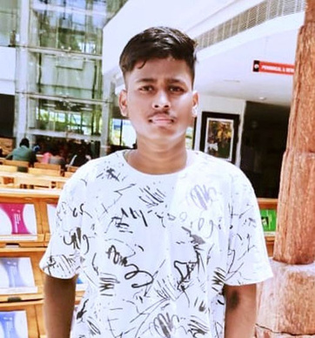
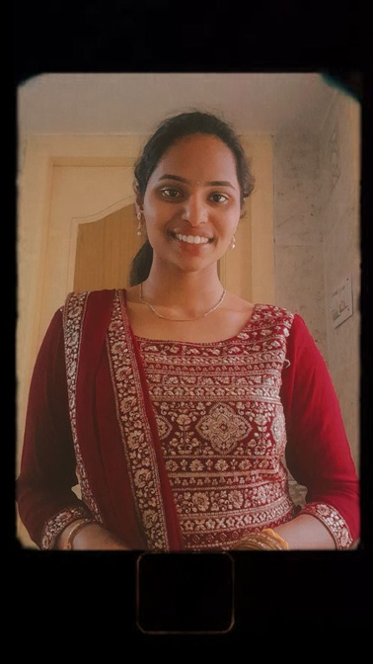
INFO SPHERE
MEET OUR TEAM
Joshitha
Hanish
Joshika
02
Akhil
Preethi

Slide 4
The Rise of AI in Retail
Personalized Experiences
Intelligent Automation
Predictive Analytics
AI-driven recommender systems analyze customer preferences and behaviors to suggest products tailored to individual needs, fostering deeper engagement and higher conversion rates.
AI-powered chatbots and virtual assistants provide 24/7 customer support, streamlining inquiries and boosting satisfaction levels.
AI models leverage historical data to forecast demand, optimize inventory, and minimize stockouts, ensuring efficient supply chain management.
04

Slide 5

We believe in the power of business to make informed decisions based on data to change how businesses operate. Our mission is to develop solutions which are predictive, proactive and practical so that the retailers are able to maximize their inventory, customer satisfaction and stay ahead in the dynamic market place.
We use innovation and AI to ensure there is a connection between information and action, enabling businesses not only to respond to trends, but predict and take advantage of them.
OUR VISION
05

Slide 6
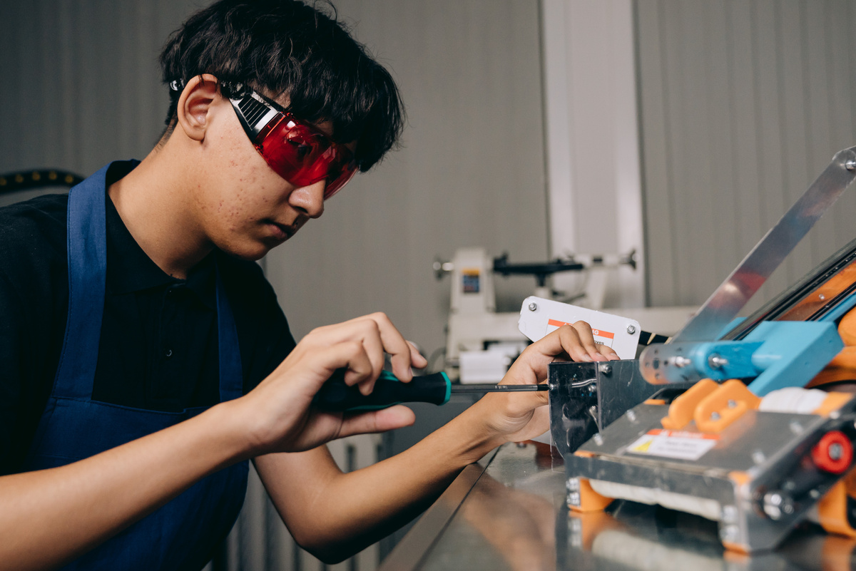
OUR MISSION
We aim to use the power of the latest AI and data analytics to deliver precise demand forecasts to businesses to support them in making the right buying and inventory choices. Through historical sales and seasonality, and market trends analyses, we intend to reduce overstocking and stockouts that enhance operational efficiency and profitability of retailers.
We will be determined to provide smart, easy to use solutions that will not only make decision-making easier but also increase customer satisfaction and retention. Innovation and continuous improvement is our endeavor to enable businesses to remain competitive and relevant in an ever-changing and competitive market.
06

Slide 7
SERVICES
Service 01
Demand forecasting based on AI - Using past sales, seasonal, and market trends, we are able to forecast the exact future demand of a product, allowing businesses to manage inventory and prevent overstocking or stockouts.
Service 02
Customized Recommendations and Smart Alerts- Our solution offers customized reorder recommendations and sends proactive alerts, which helps retailers to make timely and efficient buying decisions.
Service 03
Data-Driven Insights to grow your Business - We turn complex data on sales and the market into insights that can be acted upon and, in so doing, allow retailers to become more efficient, sell more and more satisfactorily to customers.
07

Slide 8
TECHNOLOGIES USED
Python – For building AI models, data analysis, and implementing machine learning algorithms.
Machine Learning Libraries – Such as scikit-learn, TensorFlow, and Keras for predictive modeling and demand forecasting.
Database Systems – MySQL / PostgreSQL to store and manage historical sales and product data efficiently.
Web Frameworks – Django / Flask for creating the backend system and API integration with Qwipo’s platform.
08

Slide 9
THANK YOU

